Slide 1


Deliverable 4 Final Project Presentation SEXUALLY TRANSMITTED DISEASES INFORMATION APP
Across the Board Champions
Yoshihisa Miyamoto, Changrui Zhang, Anil Gadgotra(Presenter) , Divya Datla(Presenter) , Xueting Chen, Prashanth Subrahmanyam
CS6440: Introduction to Health Informatics
April 22nd , 2019
Notes:
Welcome to the final project presentation of Sexually transmitted diseases information application which is developed by our team Across the Borders. Anil and I will be presenting our Final Project

Slide 2
Video Link to Presentation
Presentation :
https://youtu.be/LqnmMw4u_n0
Demo:
https://youtu.be/ZtM5Nb9uQ-s
GitHub:
https://github.gatech.edu/gt-cs6440-hit-spring2019/Sexually-Transmitted-Diseases-Information-App
App URL:
https://cs6440-s19-prj051.apps.hdap.gatech.edu/
Notes:
Here is the youtube link for this presentation.

Slide 3
Agenda
Research
Market Context
Needs
Research Methods
Overview
Section 1 – Info On STDs
Section 2 – CDC Information
Section 3 – Test for STDs
Section 4 – Book appointment
Application
Gantt Chart
Conclusion
Notes:
The agenda for this presentation is to provide complete description of our application.
Including the details about our research followed by the overview and
Various modules in our application
It has the application demo and Gantt Chart
And concludes with our plans for future enhancements

Slide 4
Research
Market Context:
Lots of information & assessments available online on STDs
Problem is this information is scattered and disorganized
More than 20 kinds of STDs, with multiple complexities such as pregnancy
The onus of finding and digging through information is on the patient
Needs:
A one-stop shop dedicated for STDs:
Initial self-diagnostics based on patient reporting their symptoms and profile.
Appointment scheduling
Research method
Online research of current available web and mobile applications
Research existing surveys and research to identify current issues
(From Deliverable 1)
Notes:
As discussed in deliverable one we followed our plan to research various available web application. We found out that they had some of the functionality but none are the one-stop shops. Though CDC website provides most of the information, it neither support booking nor provides latest news gathered from various sources.

Slide 5
Overview: Sexually Transmitted Diseases Information App
Goal – to develop a single interface
Modules – Info on STD’s, Test for STDs, Book Appointment and CDC Information
Uniqueness of the app – user friendly and has booking functionality.
Notes:
From the day one we are clear on our goal, to develop an application that is a single interface for all things related to sexually transmitted diseases. Users accessing our application will gather information, get suggestions on which STDs they need to get tested, book an appointment with a physician and get latest news on STD from various sources.
Coming to the modules in Our application, it has four modules which are, Info on STD’s, Test for STDs, Book Appointment and CDC Information. I will be covering Info and CDC information section and Anil will be providing detailed description of Testing and Booking sections.
Lets look at what’s unique about our app .Although CDC’s website on STD has a lot of information it does not get content from other sources. The app also has the booking functionality through which users can requesting appointment with a physician of their choice located near them.

Slide 6
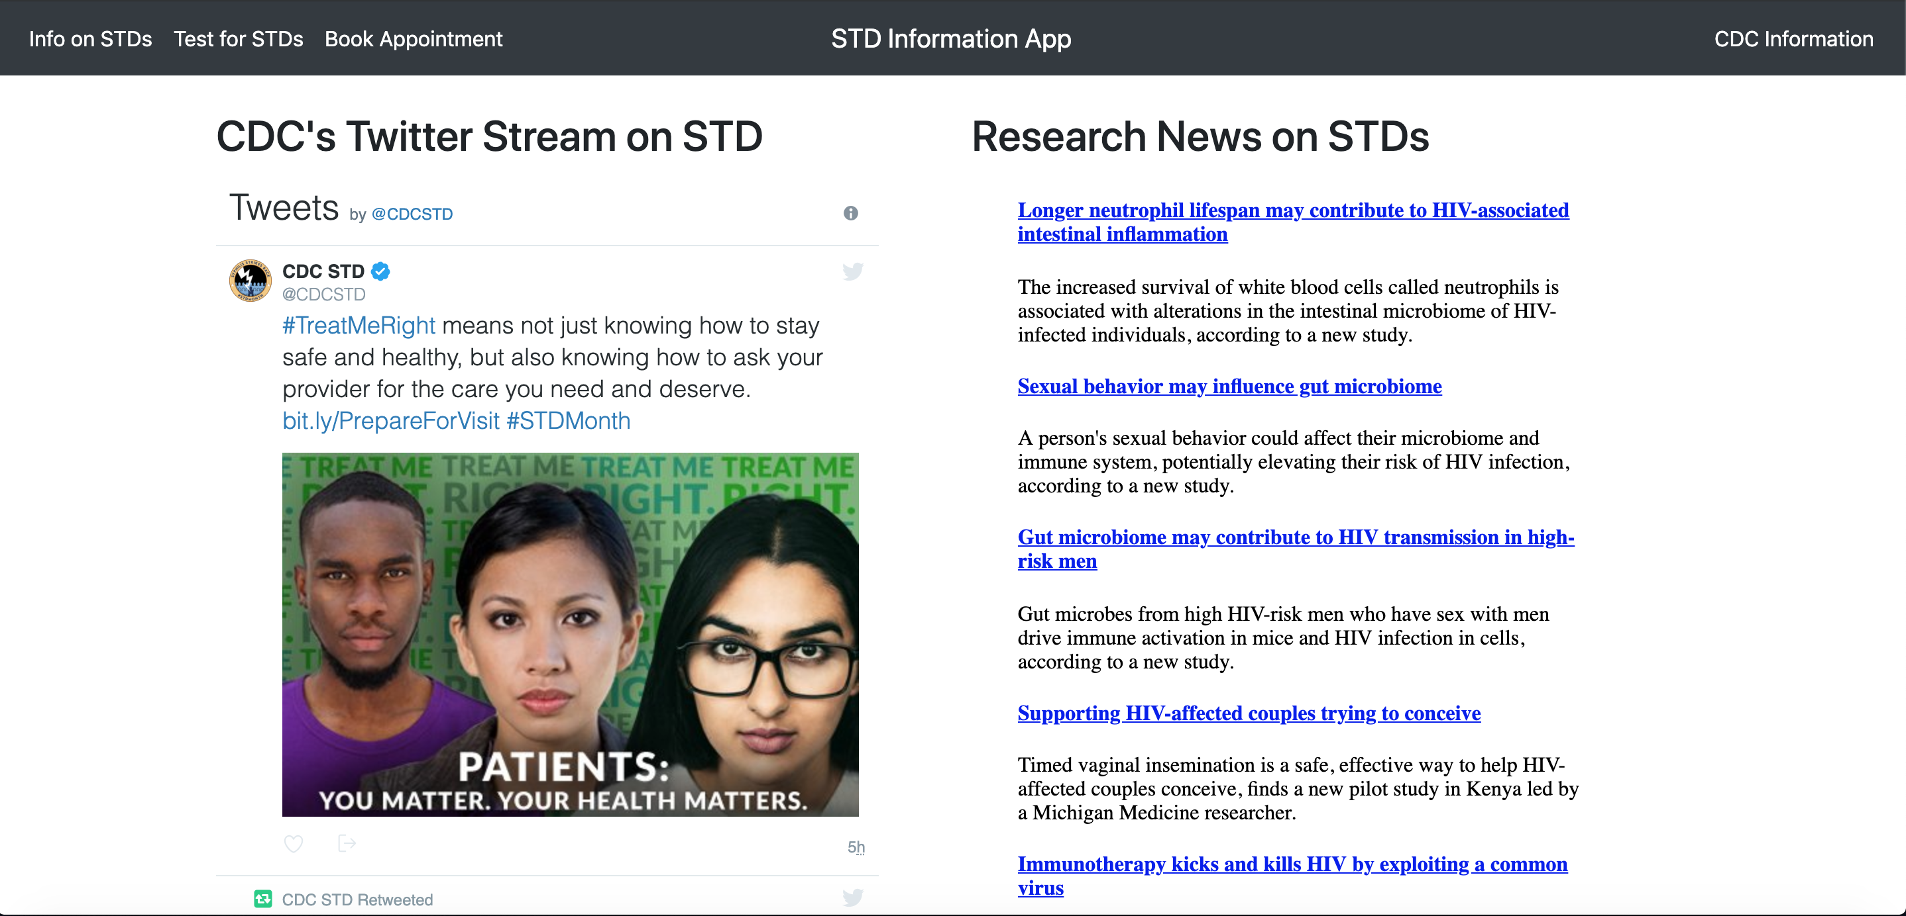
Section 1 – Info On STDs (continued)
https://www.sciencedaily.com
Notes:
The second part is the CDCs twitter feed which provides latest news in STDs. The third and final part is the STD news feed from sciencedaily that provides latest research and new articles published on science daily.

Slide 7
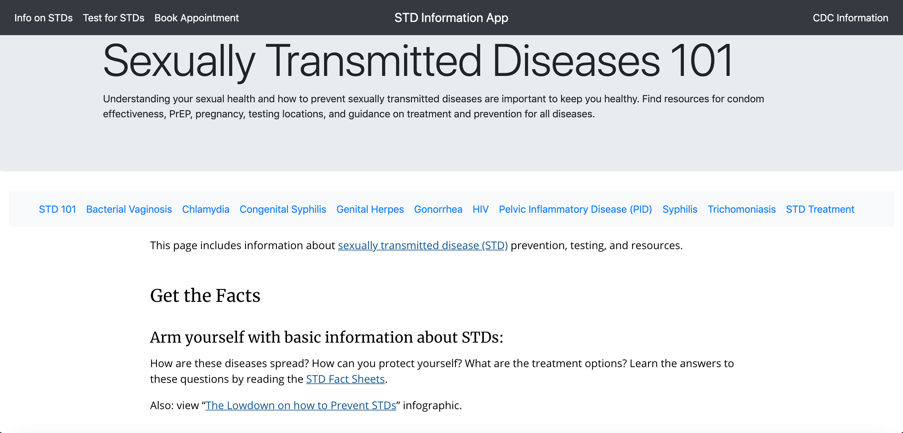
Section 2 – CDC Information
Notes:
The CDC Information section contains the links that displays the content from CDCs website. All these pages are syndicated by CDC and be accessed through our application directly.

Slide 8
Section 3 – STD testing
Based on various parameters
Year of birth
Gender
If expecting?
Ever had sex with men?
Currently having sex with men?
Provides various testing recommendations
This questionnaire is designed in accordance to the 2015 STD Treatment Guidelines.

Slide 9
Section 4 – Booking
Target audience prefers email over telephone.
Email scheduling give flexibility of scheduling at any time, ease of use.
Instead of maintaining and keeping a local database for providers, application is integrated with FHIR.
FHIR integration keeps application up to date with any changes in contact information, providers(new/closed)
Notes:
Although, traditional appointment scheduling is through phone, keeping in mind target audience for the website.
The application provides email scheduling at click of a button – any time of the day.

Slide 10
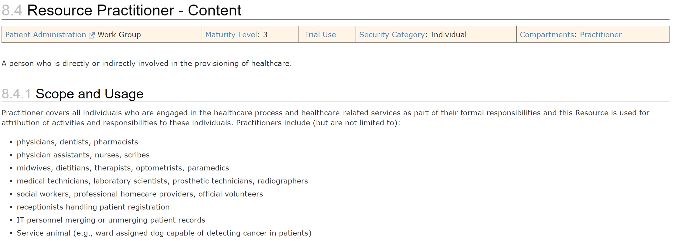
FHIR Integration
Notes:
Before I explain FHIR integration, following is the snapshot of Practitioner resource we will be primary using.

Slide 11
FHIR Integration
For a given zipcode/postalcode, nearest practitioner is queried.
User can specify specialty as:
Infectious disease physician
Consultant gynecology and obstetrics
Notes:
We will be using FHIR to fetch various providers nearby a zipcode. This query is constructed using Practitioner resource. User can filter results based for various specialities.

Slide 12
Video Link to Demo
Demo:
https://youtu.be/ZtM5Nb9uQ-s
Notes:
Here is the youtube link for this presentation.

Slide 13
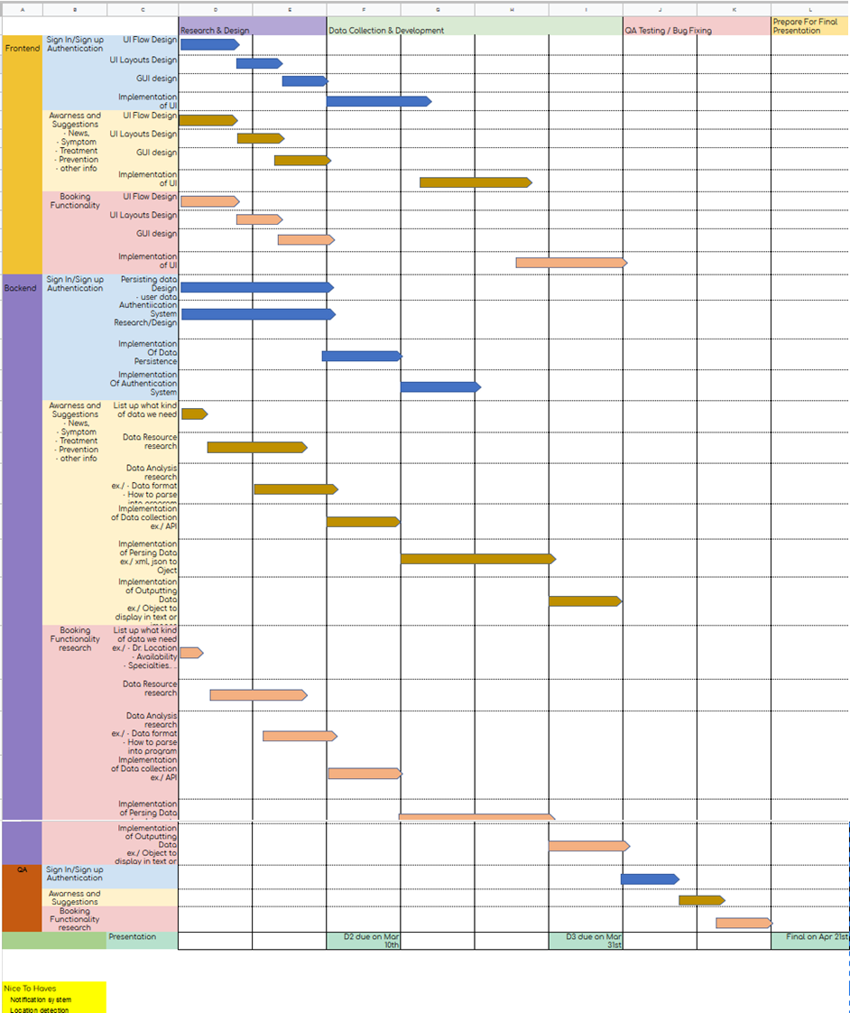
Gantt Chart
Who did what – Please Refer D3 gnat char
Notes:
This is gantt chart, showing various tasks and their progress

Slide 14
Future work
Cache server for quick results of the FHIR query.
Developing an individual user centric suggestions, preferences etc.
Integration of FHIR patient id.
Handle various privacy concerns around email scheduling of STD testing.
Notes:
Following tasks can be taken as part of future work
As FHIR query is slow, a cache serve can improve responsiveness of the site. We had this task in pipeline.
Developing an individual user centric experience will help with personalization.
Futher FHIR integration using individual user patient id
4.

Slide 15
Conclusion
The application can serve as an integrated one-stop shop from spreading awareness and education to self-diagnosis and booking appointment for clinical testing.
FHIR integration helps application to stay updated with a changing landscape of the local providers.
Provides latest information for various STDs which is presented in a user-friendly manner.

